Slide 1
Defect in QC

Slide 2
Defect(QA)
BUG ⬄NCR(None Confirmed Requirement)
Life Cycle: follow SLIM
http://teams9.sharepoint.hp.com/teams/PGS/QA/Knowledge%20Management/Forms/AllItems.aspx?RootFolder=%2fteams%2fPGS%2fQA%2fKnowledge%20Management%2fSLIM%20Training&FolderCTID=&View=%7b55BCF2C8%2dC635%2d4099%2dA573%2d224BE5E8FCDA%7d
>New(Unassigned)
>New(Assigned)
>Open(Active)
>Repair Ready
>Fixed(Validated)
>Closed(Validated)
>Open(Reopen)
>Owner(QA)
> Test Coordinator
>Owner(dev)
>Owner(dev)
>Owner(dev)
>Owner(QA)
>Owner(QA)

Slide 3
Defect(QA) -New unassigned
QA find a defect, submit it in QC
Example
Login QC(ECOIT, DIRECT_SERVICES)
Click Change Request
Click New Change Request

Slide 4
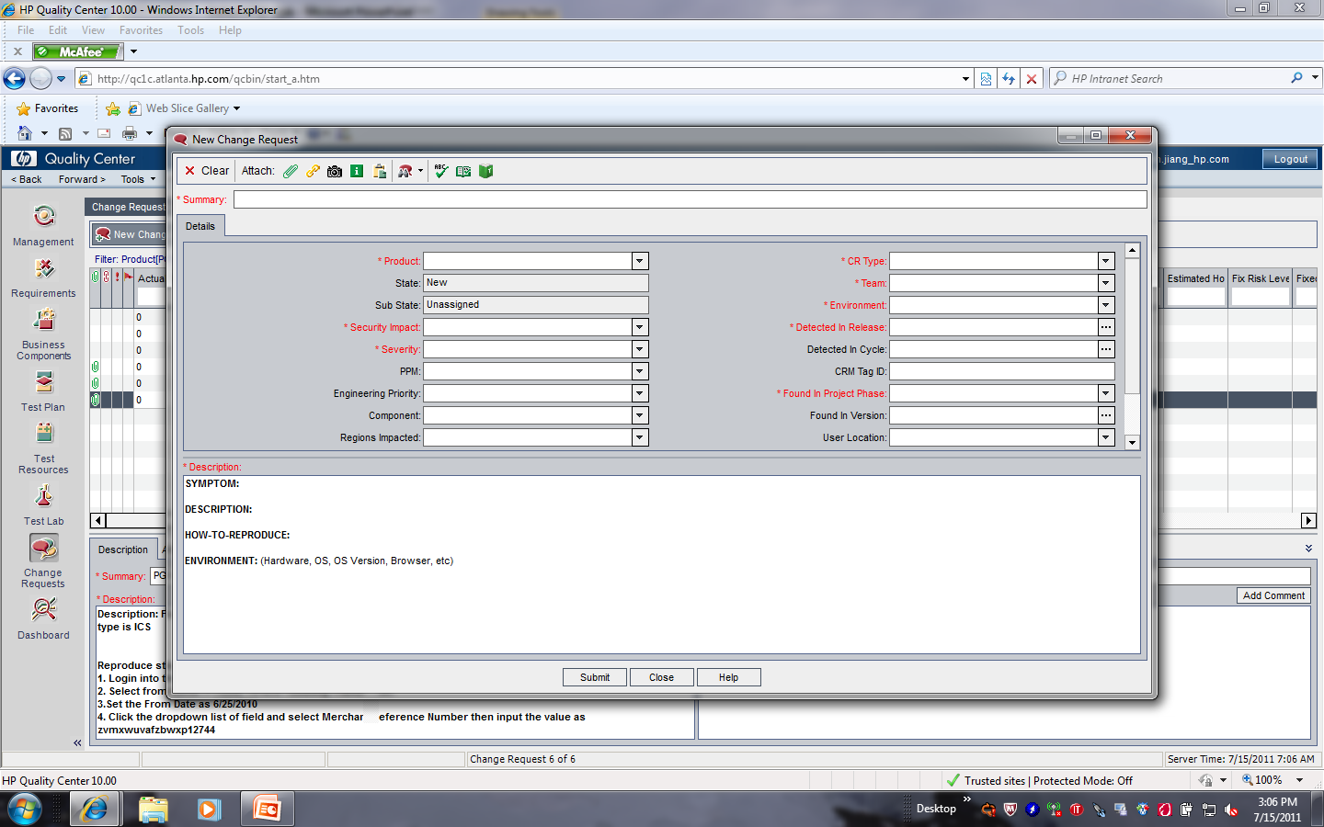
Defect(QA) -New unassigned, Example

Slide 5
Defect(QA) -New, unassigned, Example
Summary: “component: defect summary”->”FQM/RSM:…”
Product: PGS
Security Impact: Y/N, normally is “N”
Severity: 0-None, 1-Critical, 2-Urgent, 3-Medium, 4-Low
CR Type: Defect, Problem, Requirement Change
Team: _PGS_Team
Environment: ITG(DEV, Pro…)
Detected in Release: Payment Gateway->August PCI PGS Release
Found in project phrase: system testing(user acceptance testing)
Description:
Defect Description
Environment, if have, like url, ie version, OS, JDK, etc
Reproduce steps
Actual Result
Expected Result
Attachment: screenshot
Submit

Slide 6
Defect(QA) - New,Unassigned, Example
Assign to testing coordinator: fei.lai_hp.com
For coordinator role: can refer to test plan
Don’t forget to link the NCR to test set(in test lab)

Slide 7
Defect(Test Coordinator) -New, Assigned, Example
Test coordinator get the new defect
Verify the defect’s valid
valid defect
change the defect’s substate as “Assigned”
assign the defect to Owner
invalid defect
assign to submitter
add comments
change the defect as “closed” (it’s better to discuss with QA firstly to avoid reopen defect)

Slide 8
Defect(Owner-DEV) -Open, Active, Example
Owner(DEV) get the defect
Defect info clear
Change the defect’s state as “Open”
Change the defect’s substate as “Active”
To troubleshoot the issue
Defect info unclear
Change the defect’s substate as “Need more information”
Assign to defect’s submitter

Slide 9
Defect(Owner-DEV) -Repair Ready, Example
Fix the issue
Change the info for defect(Required Field)
Set the state as “Repair Ready”
Fill in PPM ID: refer to project test plan(179832: PGS EC Baseline Support FY11)
Resolution tab
Resolution
Root cause
CR Kind
Introduced In Project Phase

Slide 10
Defect(Owner-DEV) -Repair Ready, Example
Resolution
SOR Validated: Problem was validated as being due to data from the System of Record being misaligned (e.g. incorrect format, wrong values,etc.) with the Product.
Validated: Problem was validated in the Product.
Root cause
Code: Functionality coded in the release / project under test did not fulfill the design.
Data: Wrong or invalid data being processed.
Design: Design does not meet the requirement.

Slide 11
Defect(Owner-DEV) -Fixed, Example
Fixed issue code is involved in the ITG
Validate the “Repair Ready” defect in ITG
Change the info for defect
Change the defect state to “Fixed”
Change substate as “validated”
Assign to Defect submitter(QA)

Slide 12
Defect(Owner-QA) -Closed, Example
Verify the fixed issue
Close defect
Change the state to “Closed”
Change the substate to “validated”
Reopen defect(Unexpected)
Change the state to “Open”
Change the substate to “Reopen”

Slide 13
Comments
Add comments when do any action

Slide 14
Severity
1-Critical, 2-Urgent, 3-Medium, 4-Low
NCR Severity | Definition | Action
1 _ Urgent | Application down/crush No workaround | Must be fixed before release
2 _ High | Issue cause component fail Scenario fail, block most of test sets | Must be fixed before release unless agreed otherwise
3 _ Medium | Workaround acceptable. Not serious to operations. Scenario fail, minor issue with work around | Fix can be delayed until next version
4 _ Low | Prefer the application to function differently. Workaround available and acceptable. | Fix can be delayed until next version

